Slide 1

INSTITUTE : UIE
DEPARTMENT : CSE
Bachelor of Engineering (Computer Science & Engineering)
PROJECT BASED LEARNING IN JAVA
(20CST-319/20ITT-319)
TOPIC OF PRESENTATION:
HashMap, TreeMap, HashSet in Java.
DISCOVER . LEARN . EMPOWER

Slide 2

Lecture Objectives
In this lecture, we will discuss:
HashMap, TreeMap, HashSet in Java.

Slide 3
Java HashSet class
Java HashSet class is used to create a collection that uses a hash table for storage. It inherits the AbstractSet class and implements Set interface.
The important points about Java HashSet class are:
HashSet stores the elements by using a mechanism called hashing.
HashSet contains unique elements only.
Difference between List and Set
List can contain duplicate elements whereas Set contains unique elements only.

Slide 4
Java HashSet class
Hierarchy of HashSet class
The HashSet class extends AbstractSet class which implements Set interface.
The Set interface inherits Collection and Iterable interfaces in hierarchical order.
HashSet class declaration
Let's see the declaration for java.util.HashSet class.
public class HashSet<E> extends AbstractSet<E> implements Set<E>, Cloneable, Serializable

Slide 5
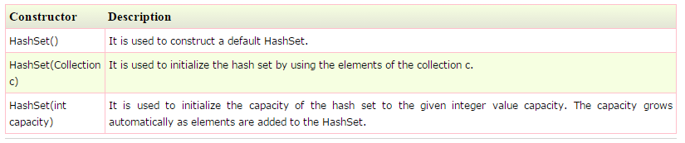
Constructors of Java HashSet class

Slide 6
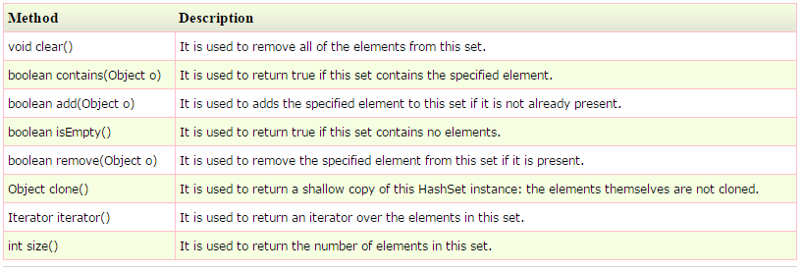
Methods of Java HashSet class:

Slide 7
Java LinkedHashSet class
Java LinkedHashSet class is a Hash table and Linked list implementation of the set interface. It inherits HashSet class and implements Set interface.
The important points about Java LinkedHashSet class are:
Contains unique elements only like HashSet.
Provides all optional set operations, and permits null elements.
Maintains insertion order.

Slide 8
Hierarchy of LinkedHashSet class
The LinkedHashSet class extends HashSet class which implements Set interface.
The Set interface inherits Collection and Iterable interfaces in hierarchical order.
LinkedHashSet class declaration
Let's see the declaration for java.util.LinkedHashSet class.
public class LinkedHashSet<E> extends HashSet<E> implements Set<E>, Cloneable, Serializable

Slide 9
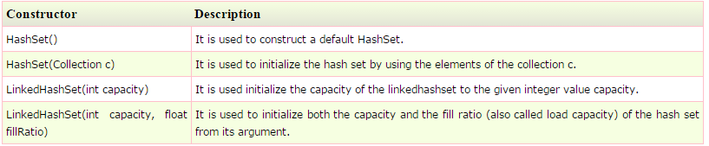
Constructors of Java LinkedHashSet class

Slide 10
Java TreeSet class
Java TreeSet class implements the Set interface that uses a tree for storage.
It inherits AbstractSet class and implements NavigableSet interface. The objects of
TreeSet class are stored in ascending order.
The important points about Java TreeSet class are:
Contains unique elements only like HashSet.
Access and retrieval times are quiet fast.
Maintains ascending order.

Slide 11
Hierarchy of TreeSet class
As shown in diagram, Java TreeSet class implements NavigableSet interface.
The NavigableSet interface extends SortedSet, Set, Collection and Iterable interfaces in hierarchical order
TreeSet class declaration
Let's see the declaration for java.util.TreeSet class.

Slide 12
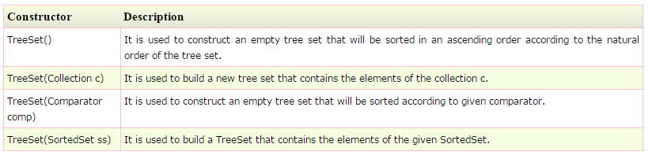
Constructors of Java TreeSet class

Slide 13
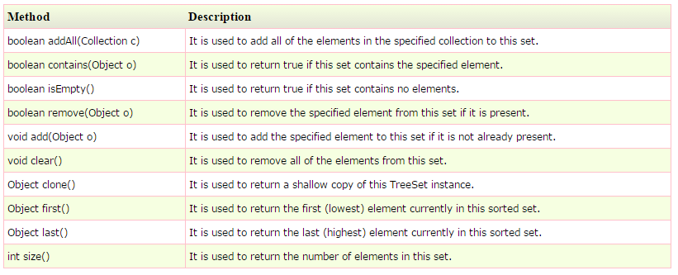
Methods of Java TreeSet class

Slide 14
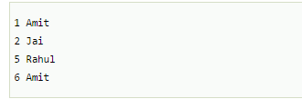
Java Map Interface
A map contains values on the basis of key i.e. key and value pair. Each key and value pair is known as an entry. Map contains only unique keys.
Map is useful if you have to search, update or delete elements on the basis of key.

Slide 15
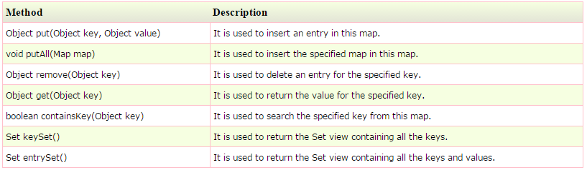
Java Map Interface
Useful methods of Map interface

Slide 16

Map.Entry Interface
Entry is the sub interface of Map. So we will be accessed it by Map.Entry name.
It provides methods to get key and value.
Methods of Map.Entry interface

Slide 17
Java HashMap class
Java HashMap class implements the map interface by using a hashtable. It inherits AbstractMap class and implements Map interface.
The important points about Java HashMap class are:
A HashMap contains values based on the key.
It contains only unique elements.
It may have one null key and multiple null values.
It maintains no order.

Slide 18
Java HashMap class
Hierarchy of HashMap class
As shown in the figure, HashMap class extends AbstractMap class and implements Map interface.
HashMap class declaration
Let's see the declaration for java.util.HashMap class.
public class HashMap<K,V> extends AbstractMap<K,V> implements Map<K,V>, Cloneable, Serializable

Slide 19
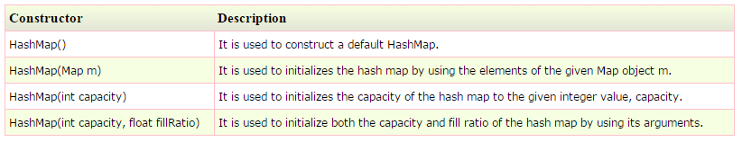
Java HashMap class
HashMap class Parameters
Let's see the Parameters for java.util.HashMap class.
K: It is the type of keys maintained by this map.
V: It is the type of mapped values.
Constructors of Java HashMap class

Slide 20
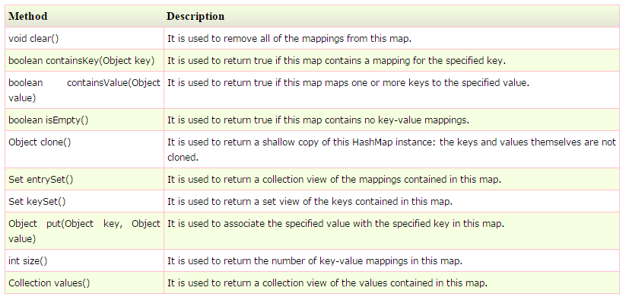
Java HashMap class
Methods of Java HashMap class

Slide 21
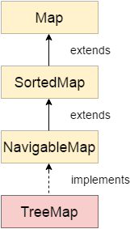
Java TreeMap class
Java TreeMap class is a red-black tree based implementation. It provides an efficient means of storing key-value pairs in sorted order.
The important points about Java TreeMap class are:
Java TreeMap contains values based on the key. It implements the NavigableMap interface and extends AbstractMap class.
Java TreeMap contains only unique elements.
Java TreeMap cannot have a null key but can have multiple null values.
Java TreeMap is non synchronized.
Java TreeMap maintains ascending order.

Slide 22
TreeMap class declaration
Let's see the declaration for java.util.TreeMap class.
public class TreeMap<K,V> extends AbstractMap<K,V> implements NavigableMap<K,V>, Cloneable, Serializable
TreeMap class Parameters
Let's see the Parameters for java.util.TreeMap class.
K: It is the type of keys maintained by this map.
V: It is the type of mapped values.

Slide 23
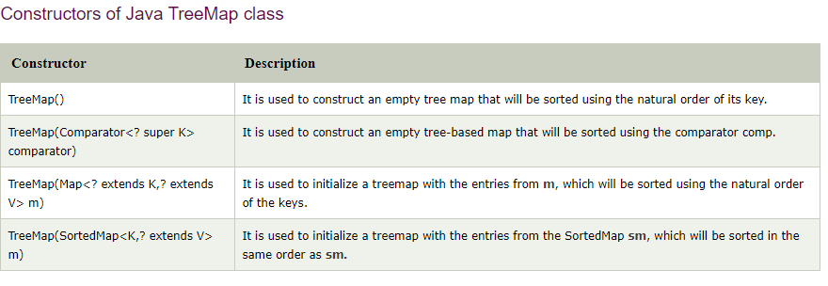

Slide 24
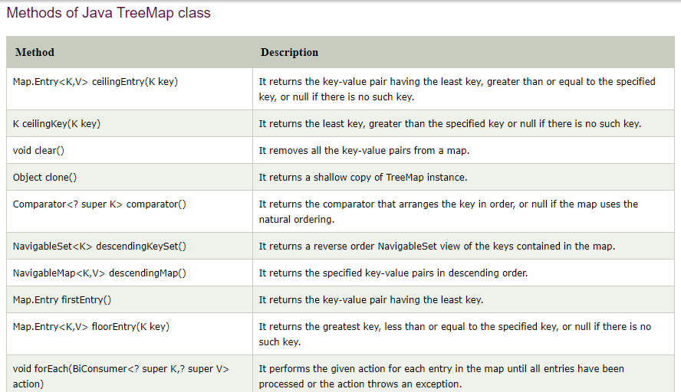

Slide 25
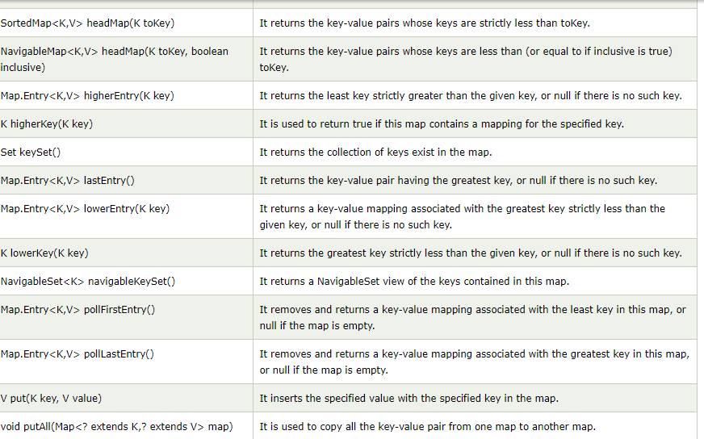

Slide 26
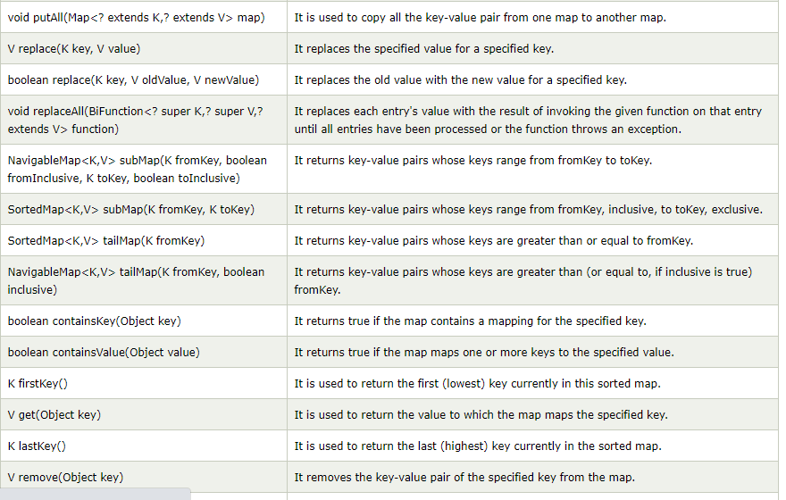

Slide 27
QUIZ:
What will be the output of the following Java program?
import java.util.*;
class Maps {
public static void main(String args[]) {
TreeMap obj = new TreeMap();
obj.put("A", new Integer(1));
obj.put("B", new Integer(2));
obj.put("C", new Integer(3));
System.out.println(obj.entrySet());
}
}

Slide 28
Summary:
In this session, you were able to :
• HashMap, TreeMap, HashSet in Java.

Slide 29
References:
Books:
1. Balaguruswamy, Java.
2. A Primer, E.Balaguruswamy, Programming with Java, Tata McGraw Hill Companies
3. John P. Flynt Thomson, Java Programming.
Video Lectures :
https://youtu.be/VvDTro4Shzg
Reference Links:
https://www.javatpoint.com/collections-in-java
https://www.geeksforgeeks.org/collections-in-java-2/
https://beginnersbook.com/java-collections-tutorials/
https://www.tutorialspoint.com/java/java_collections.htm
https://docs.oracle.com/javase/7/docs/api/java/util/Collection.html
https://docs.oracle.com/javase/8/docs/technotes/guides/collections/overview.html
https://www.edureka.co/blog/java-collections/

Slide 30
THANK YOU

